Slide 1
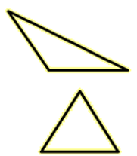
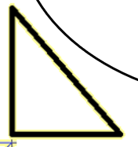
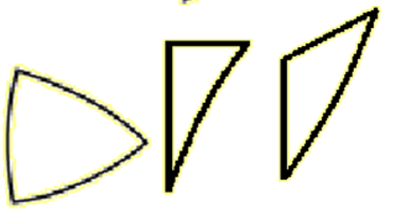

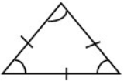
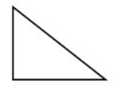
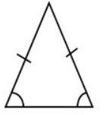
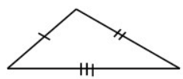
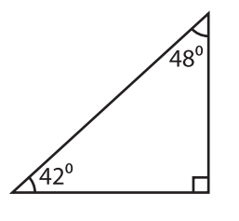
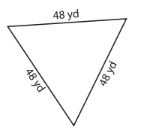
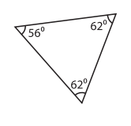
Subtopic G1.5 - Naming, labelling and recognising the features of triangles
LEARNING OUTCOME: To be confident identifying triangles and solving problems related to their angles
Objectives:
Keywords:
- Triangle
- Isosceles
- Equilateral
- Scalene
To find a missing interior angle in a triangle.
To solve multi-step angle problems involving triangles.
Definition
A two-dimensional shape made of 3 connected straight lines that create 3 interior angles
Characteristics
3 straight sides and 3 angles
two dimensional
angles sum to 180º
Examples
Triangle
Non - Examples
TYPES OF TRIANGLE
- three equal sides - three equal angles |  | - two equal sides - two equal angles | - all sides and angles are different
Equilateral Right-angled Isosceles Scalene
_______________
_______________
_______________
_______________
 | Example 1 – I do… | Example 2 – We do… | Example 3 – You do…
Steps | What type of triangle is shown?
Look for a feature of a triangle listed above Write down which type of triangle
Right-angled Equilateral Isosceles

Slide 2
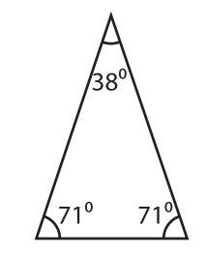
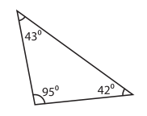
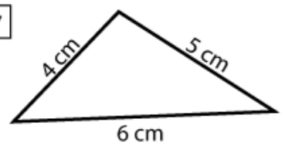
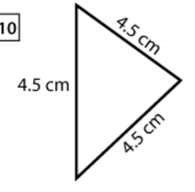
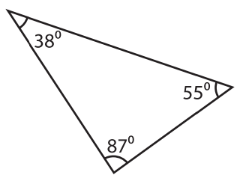
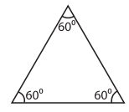

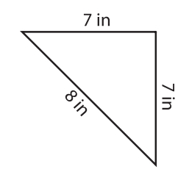
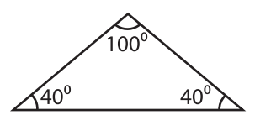
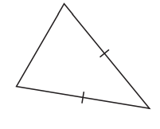
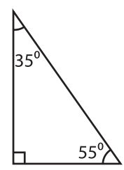
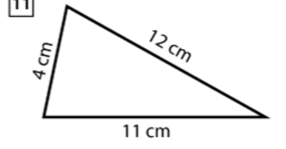
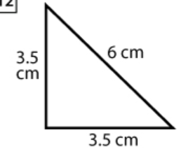
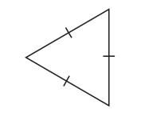
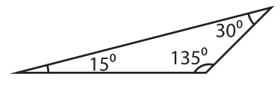
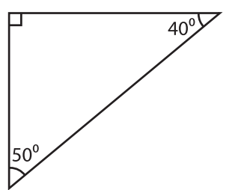
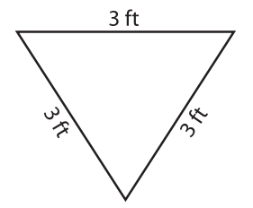
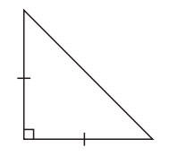
Independent Practice
Question 1. Identify which type of triangle is shown.
a) _______________________ | b) _______________________ | c) _______________________
d) _______________________ | e) _______________________ | f) _______________________
g) _______________________ | h) _______________________ | i) _______________________
j) _______________________ | k) _______________________ | l) _______________________
m) _______________________ | n) _______________________ | o) _______________________
p) _______________________ | q) _______________________ | r) _______________________
Isosceles Scalene Scalene
Equilateral Scalene Equilateral
Right-angled Isosceles Isosceles
Isosceles Scalene Right-angled
Isosceles Equilateral Scalene
Right-angled Equilateral Isosceles right-angled

Slide 3

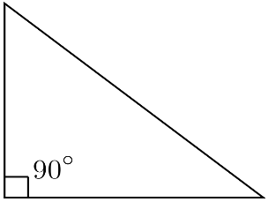







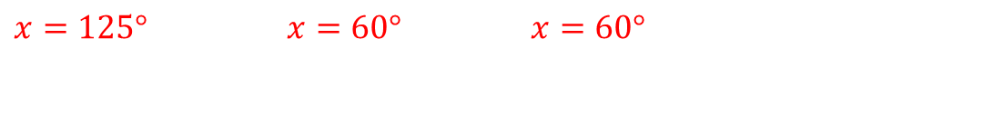
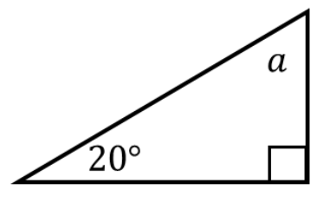
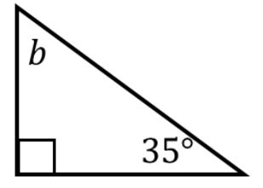
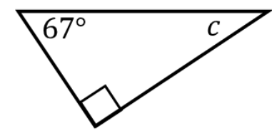



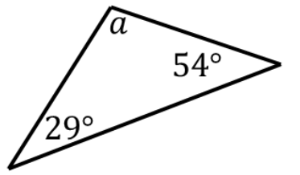
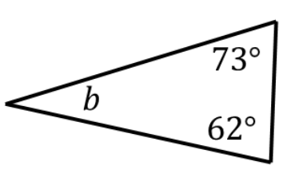
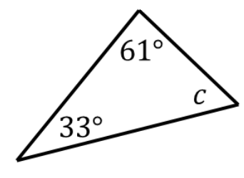



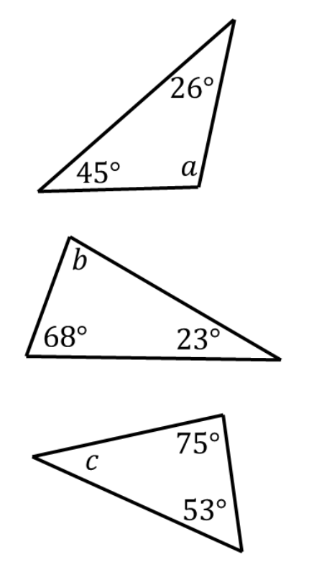



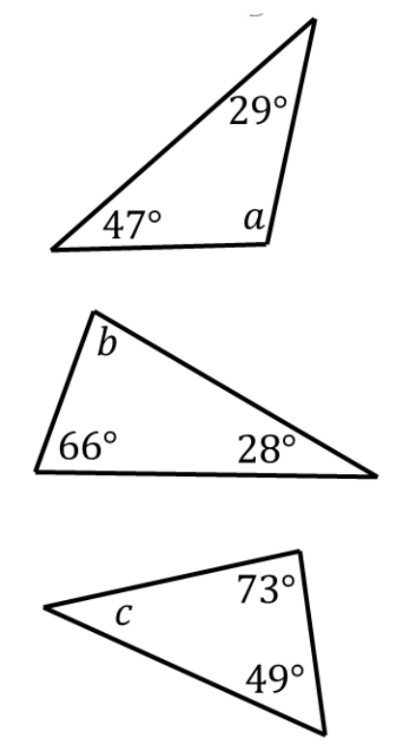



Finding missing angles in triangles
Example 4 - I do…
Example 5 - We do…
Example 6 – You do…
Steps | Calculate the missing angle
Identify the three interior angles of the triangle. Subtract from 180° to find the missing angle
Independent Practice
Question 2. Calculate any missing angles
a) | b) | c)
d) | e) | f)
g) | h) | i)
j) | k) | l)

Slide 4
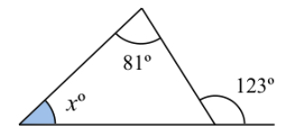
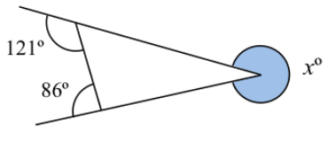
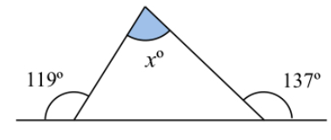






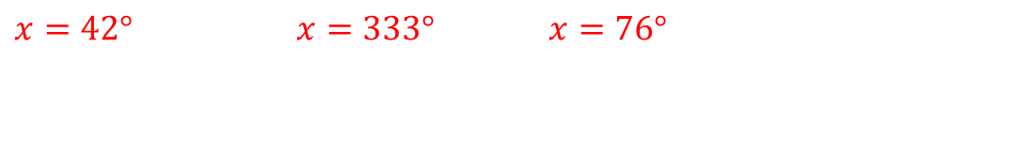
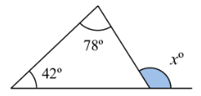
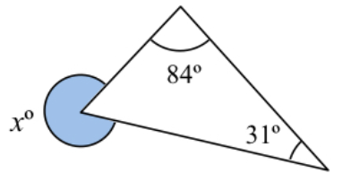







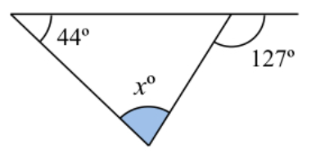
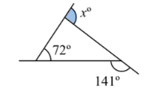
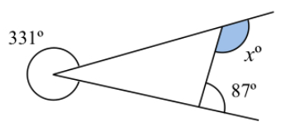









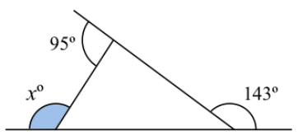
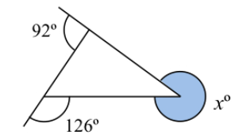
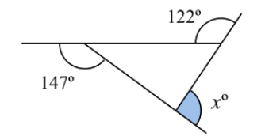











Example 7 - I do…
Example 8 - We do…
Example 9 – You do…
Steps | Calculate the missing angle
Identify the three interior angles of the triangle. Subtract from 180° to find the missing angle
Independent Practice
Question 3. Calculate any missing angles
a) | b) | c)
d) | e) | f)
g) | h) | i)

Slide 5
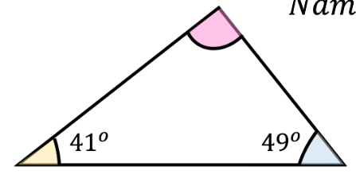



























Question 4. Identify which type of triangle is shown (scalene, isosceles, right angled or equilateral).
a) | b)
c) | d)
e) | f)
Right-angled
Scalene
Scalene
Right-angled isosceles
Scalene
Right-angled
Question 5. Find the missing angles
a)
b)
c)

Slide 6




Definition
Characteristics
Isosceles triangles can be right-angled or non-right angled.
Isosceles triangles may be seen rotated so that the two base angles are not always on the base!
For example:
If three sides of one triangle are equal to three sides of another triangle, the triangles are congruent.
Examples
Angles in an isosceles triangle
Non - Examples
Question 6. Show which angles would be equal in each of these isosceles triangles
a) | b) | c) | d)
e) | f) | g) | h)

Slide 7
























Example 10 - I do…
Example 11 - We do…
Example 12 – You do…
Steps | Angles in an isosceles triangle - Calculate the missing angle
Identify the three interior angles of the triangle. Identify which of the angles are equal and label accordingly. Subtract from 180° to find the missing angle
Independent Practice
Question 7. Calculate the size of x
a) | b) | c)
d) | e) | f)

Slide 8






















g) | h) | i)
j) | k) | l)
Example 13 - I do…
Example 14 - We do…
Example 15 – You do…
Steps | Calculate the missing angle
Identify the three interior angles of the triangle. Identify which of the angles are equal and label accordingly. Subtract from 180° to find the total of the two angles Halve to find the missing angle

Slide 9






























Independent Practice
Question 8. Calculate the size of x
a) | b) | c)
d) | e) | f)
g) | h) | i)
j) | k) | l)

Slide 10



























Question 9. Calculate the size of x.
a) | b) | c)
Question 13.
Pair 1
Pair 2

Slide 11



Skills Check
Find the missing angle.
a) 96º b) 84º
c) 64º d) 264º
Find the missing angle.
a) 87º b) 93º
c) 49º d) 92º
Find the missing angle.
a) 65º b) 130º
c) 57.5º d) 50º
Find the missing angle.
a) 69º b) 42º
c) 96º d) 138º

